Slide 1
Box: Reusing functions across projects
Annie Yu
Epidemiological Programmer, Hertfordshire County Council
Annie.yu@hertfordshire.gov.uk
NHS-R Conference 2021 | 2021-11 | PH.Intelligence@hertfordshire.gov.uk

Slide 2
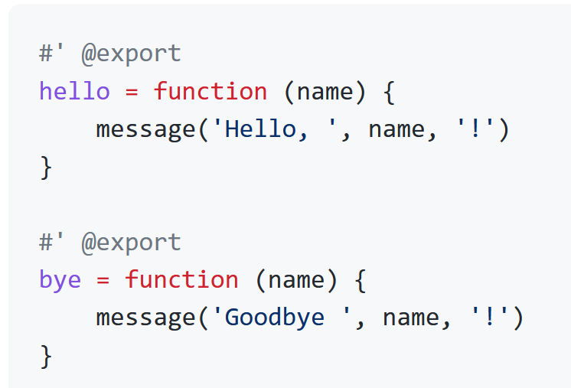
What is box?
Box is an R package that allows you to write, save, and use modular code without requiring the user to create entire packages.
https://github.com/klmr/box
NHS-R Conference 2021 | 2021-11 | PH.Intelligence@hertfordshire.gov.uk

Slide 3
Example

Slide 4
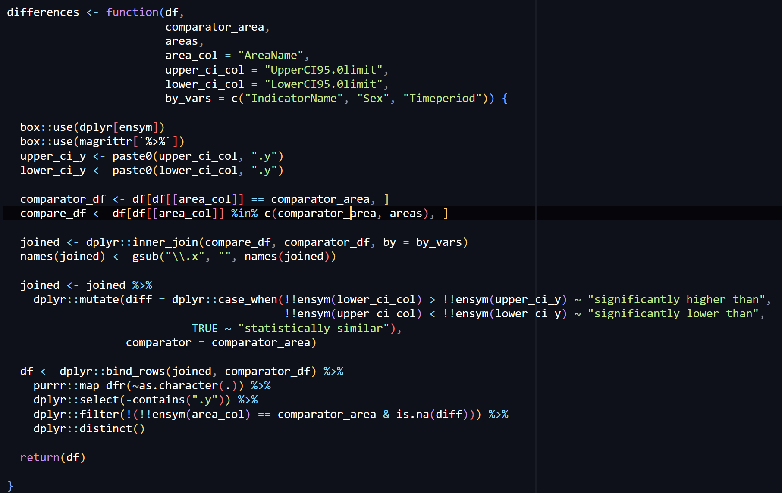
Scenario: A colleague has developed a useful function that will be useful for the for the rest of the team. What next?

Slide 5
Package development lite
An additional benefit to using box is it opens the door to package-making
Box modules are similar to packages
Forces you to “import” dependent packages and namespace thoroughly
Can create help pages for each function
Uses roxygen tags
Modular code can be easily transferred to package repo if needed

Slide 6
One way: Everyone copies and pastes the code to every project, causing duplication of code across the team The better way: Box modules

Slide 7
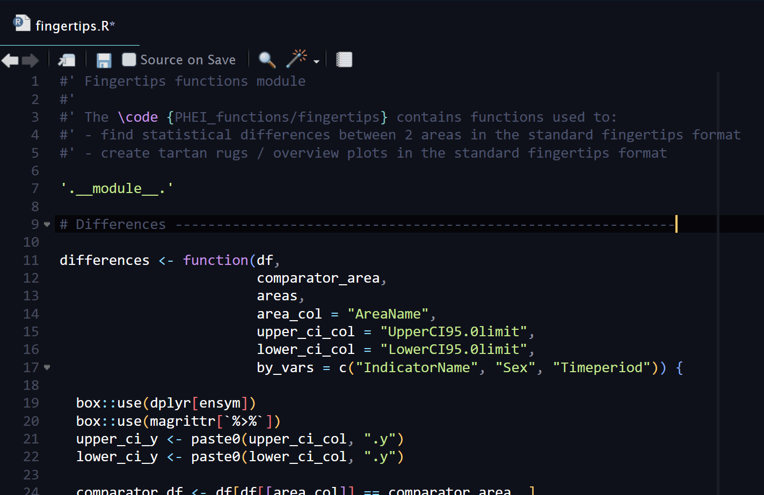
Save the function code into a new script.
(We can put other similarly useful functions within this code if needed.)

Slide 8
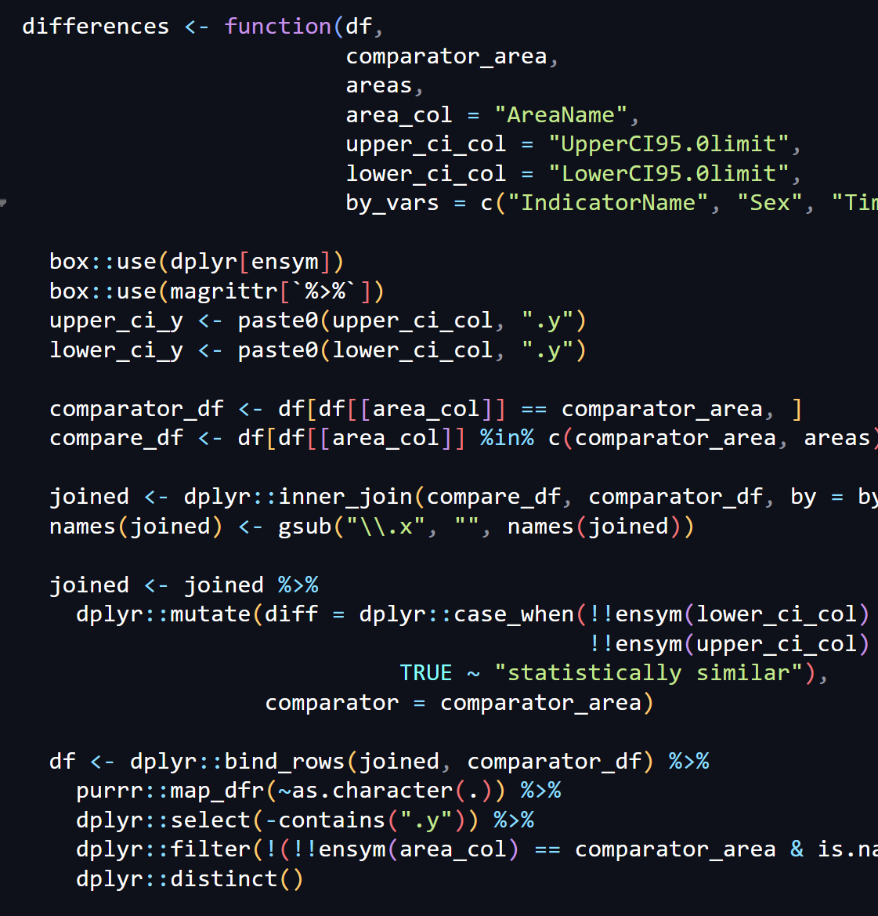
To call functions from external packages, use box::use() or namespace within the code.
This is similar to how, when creating packages, you will import these packages beforehand and namespace thoroughly in the code.

Slide 9
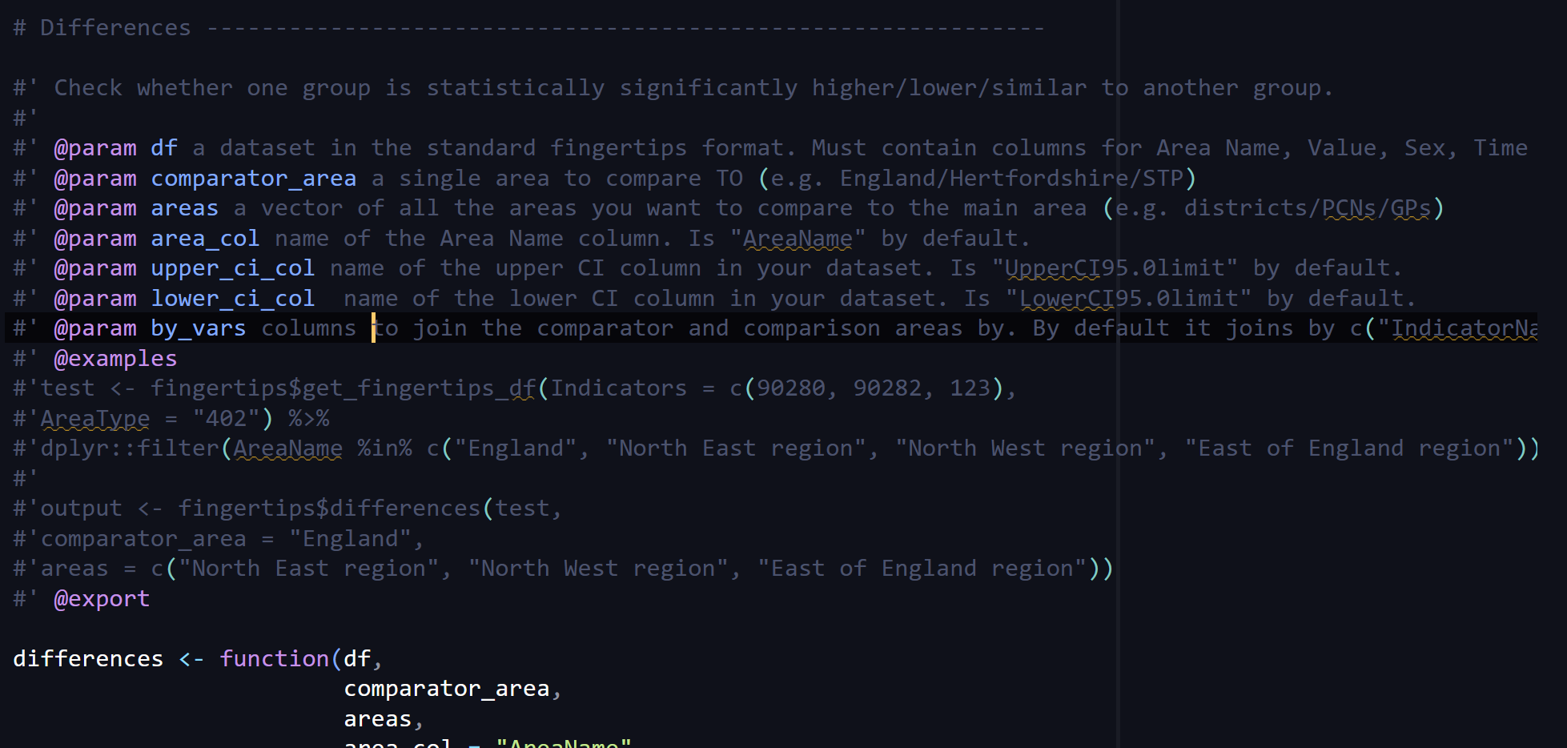
Use roxygen tags the same way you would do when writing for a package.
@param and @export are non-optional.
This makes it easy for you to transfer this code to a package if you want to later.

Slide 10
That’s it! Your modular code is now re-usable.

Slide 11
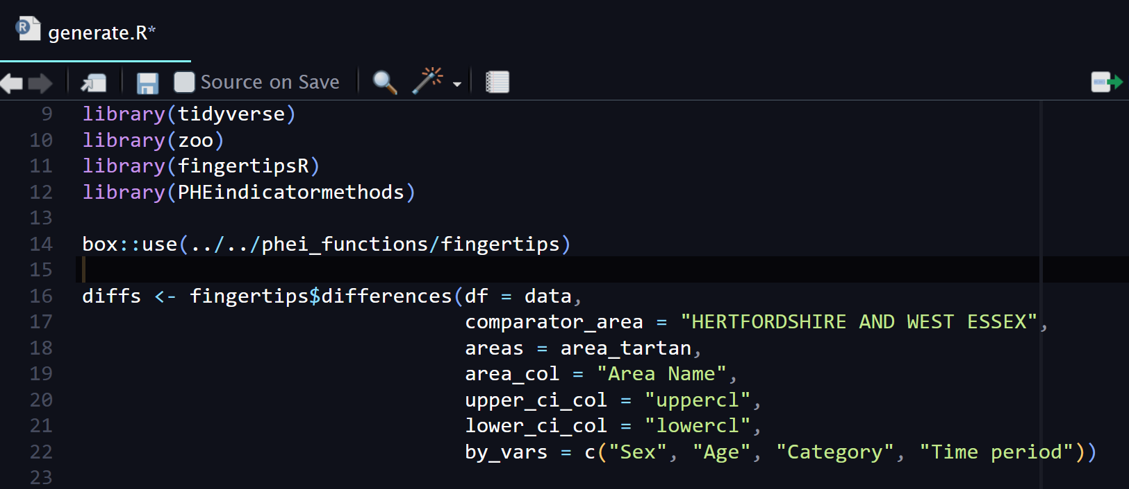
All that’s left to do is use and organise these types of scripts however you want.
Then, call the modular code using box::use and the path to the script

Slide 12
Notice that to use the differences() function we just added, we need to namespace fingertips$, the name of the module we stored it in. This means we can store more functions within the fingertips module and call them the same way.

Slide 13
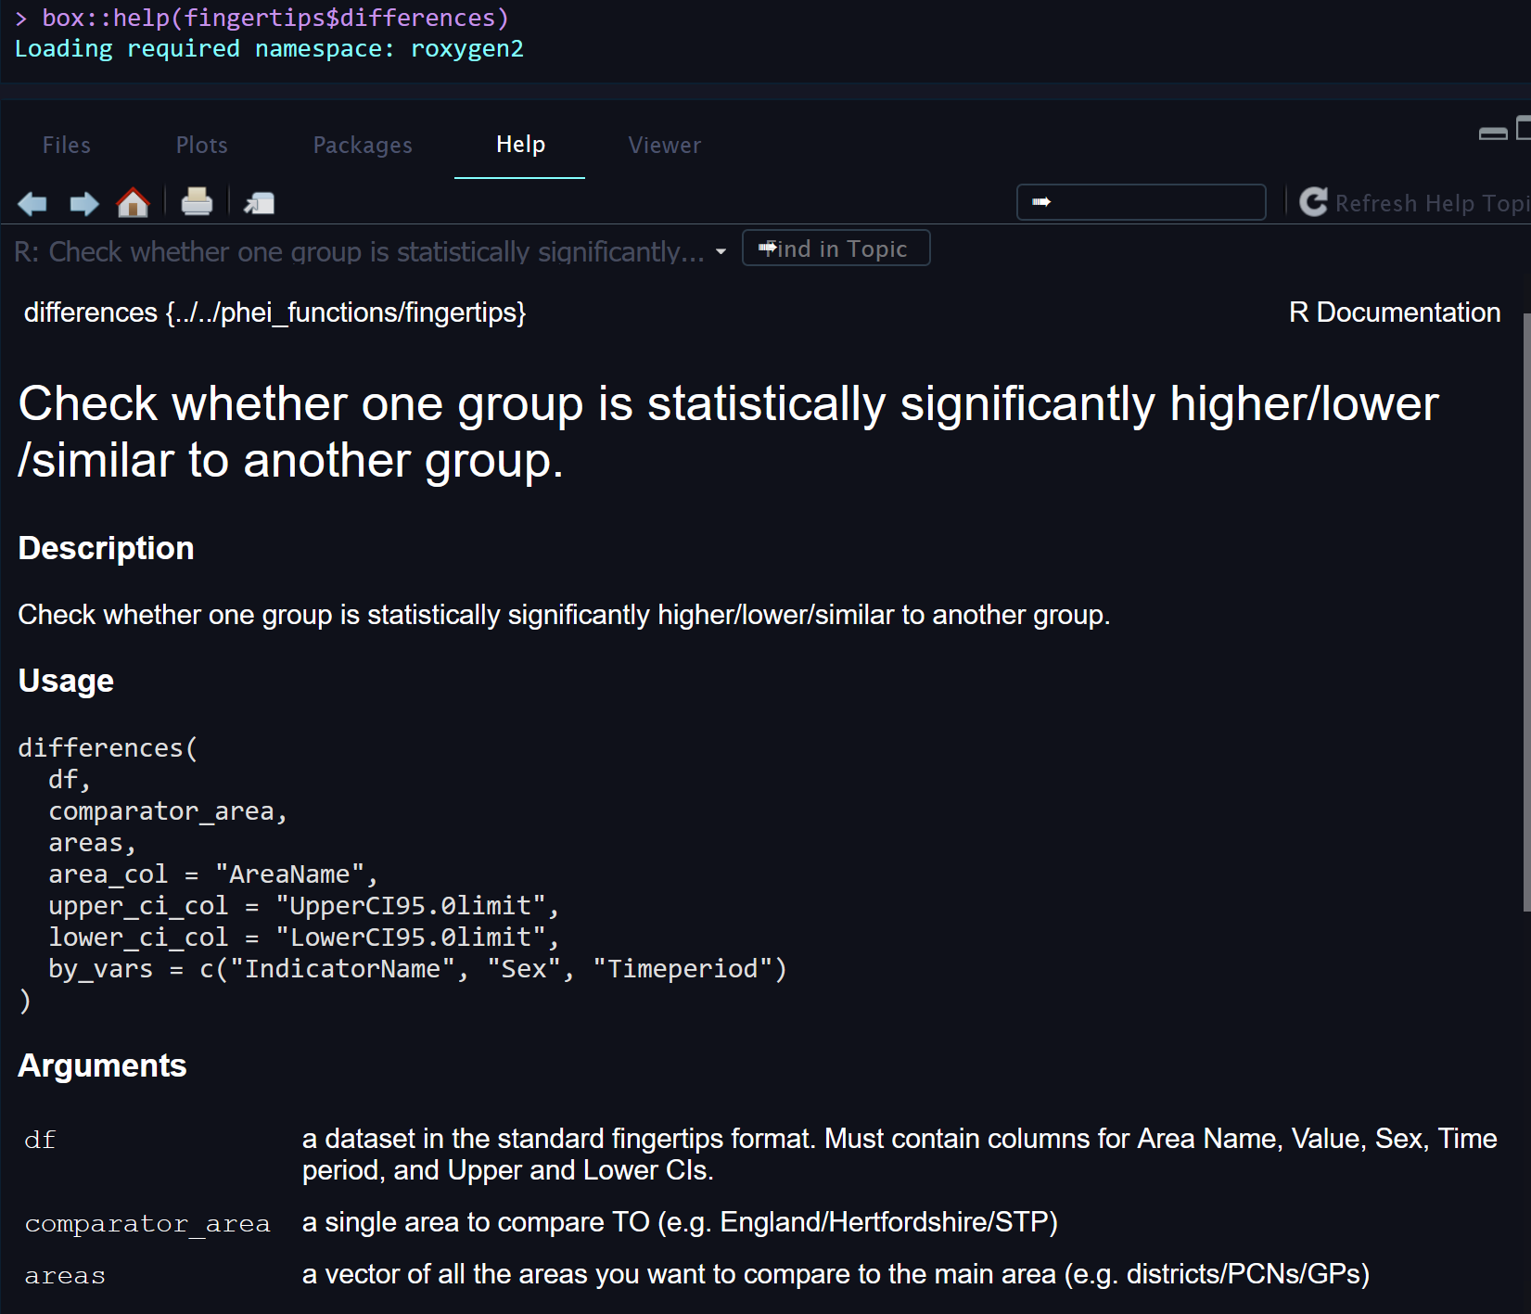
To view help pages for each function, use box::help()

Slide 14
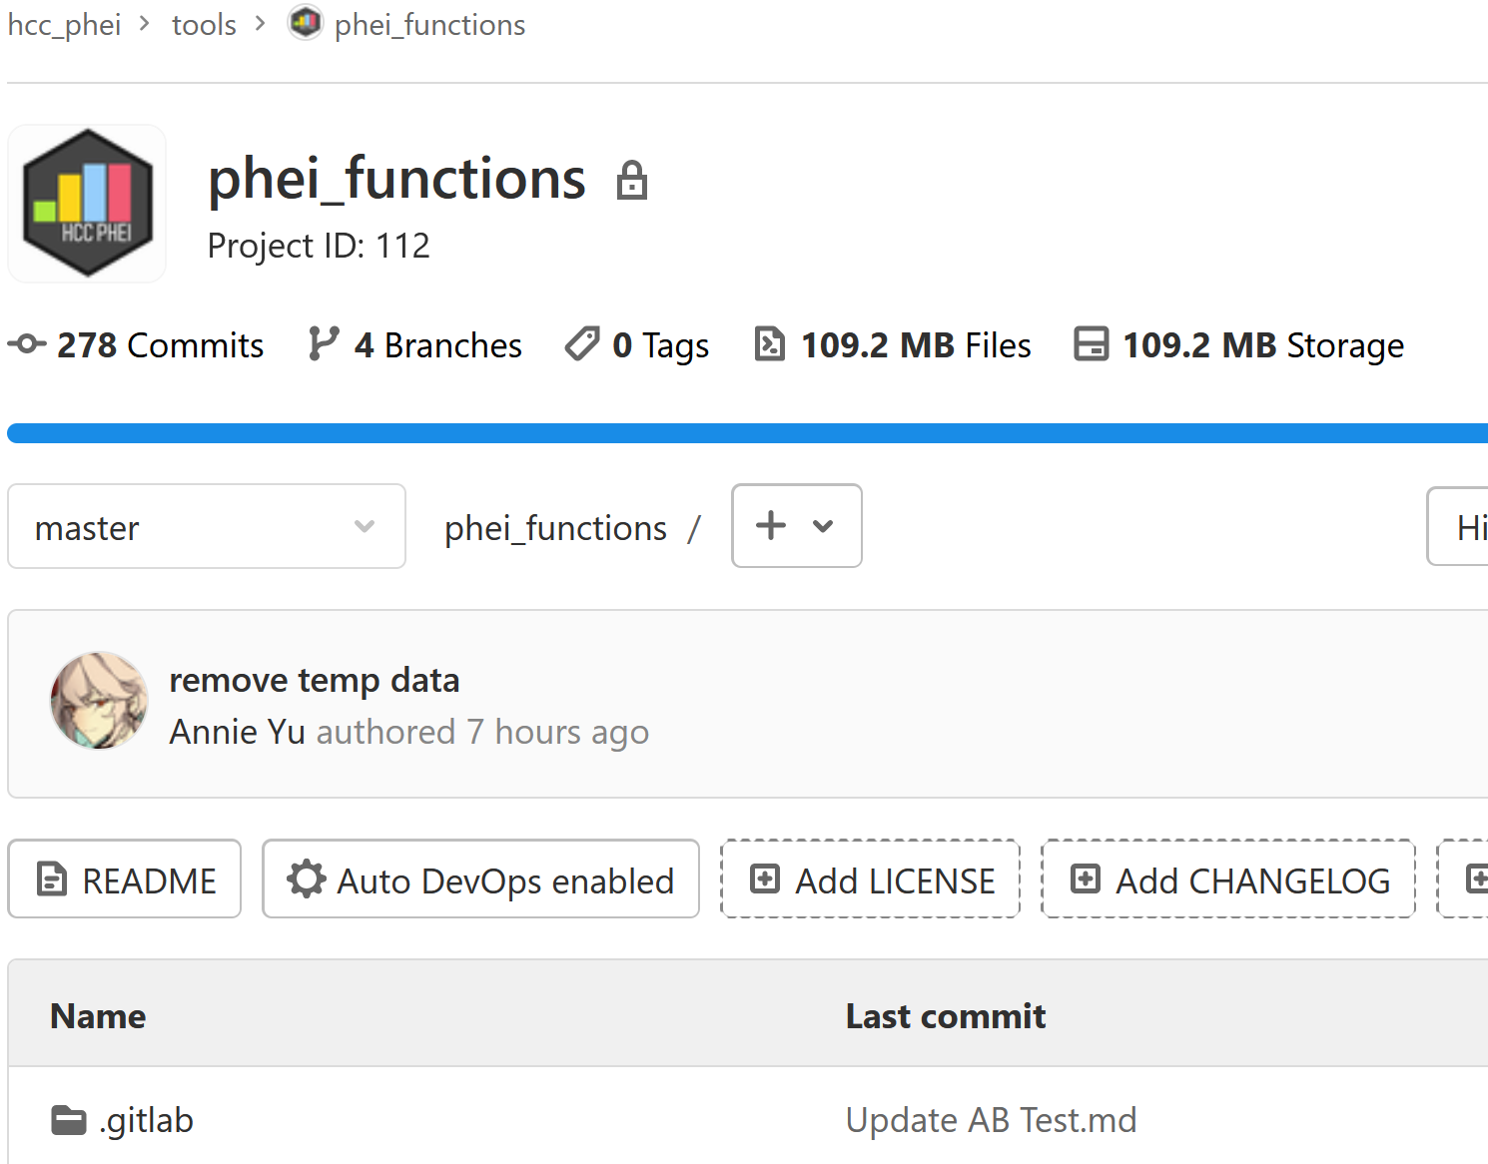
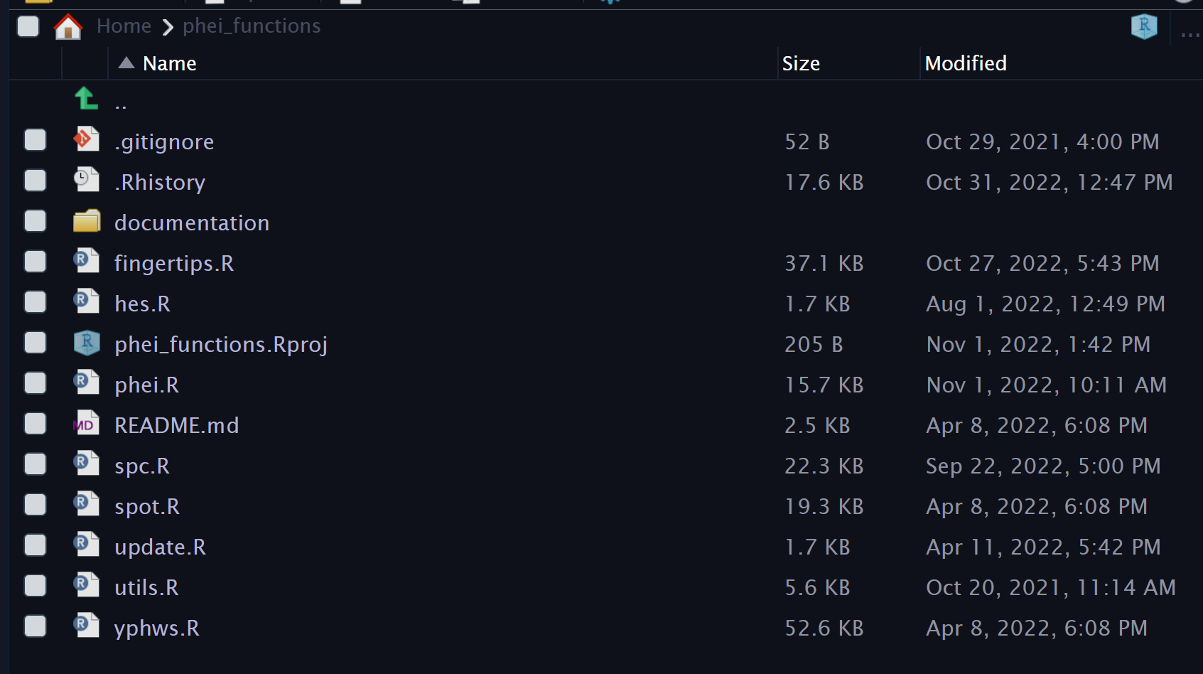

Slide 15
Why use box?
What if you have a few functions that you reuse regularly across projects, but you do not want to package them because:
They don’t seem “significant” enough to package
You can’t publish a package to GitHub due to sensitive information included in the functions
You just need a quick way to call them across projects and don’t want to spend time learning package development

Slide 16
Pros
Quick and intuitive to use
Reduces duplication of code
Gateway to packaging, at least for us
Provides an alternative to packaging (albeit not as good as packaging in some ways!)
Can be organised and documented easily

Slide 17
Cons
Cannot be used in deployed Shiny apps, as it relies on code existing in local folders.
Cannot be used in deployed Rmarkdown documents easily for the same reason.
Need to adjust paths if calling module from inner folders
Need to manually “update” modules

Slide 18
Thank you!
annie.yu@hertfordshire.gov.uk

